Slide 1
Female reproductive system
It is divided in to the following structural units:
1-paired ovaries.
2-paired oviducts (fallopian tube).
3-uterus-cervix.
4-vagina.
Functions:
_production of female gametes, ovum and reception of spermatozoa.
_providing a suitable environment for fertilization &implantation of the fertilized ovum.
_expulsion of the fetus, produce female sex hormones.
_houses and nourish conceptus during pregnancy.

Slide 2
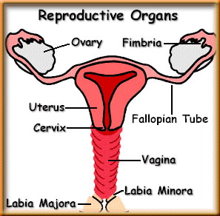
Major Organs

Slide 3
Ovaries
Are almond- shaped bodies approximately 3cm long, 1.5 cm wide, 1cm thick, paired gland act as:
-exocrine function, maturation and release of oocyte.
-endocrine function, secretion of estrogen and progesterone.
The ovary is subdivided in to:
_Cortex
_Medulla
-Each ovary is covered by a simple cuboidal epithelium, the germinal epithelium continuous with the mesothelium and overlying a layer of dense connective tissue capsule, the tunica albuginea.

Slide 4
-Most of the ovary consist of the cortex, region filled with a highly cellular c t stroma and many ovarian follicles, which in the adult ovary vary greatly in size.
-The most internal part of the ovary is the medulla, which contains loose c t and blood vessels entering the organ through the hilum, there are no sharp limits between the ovarian cortical and medullary regions.
-The surface epithelium of the ovary is called the mesothelium which change at the hilum in to cuboidal epithelium (germinal epithelium), which sits on the tunica albuginea.
-The hilus of the ovary is where all nerves and vessels enter the organ.

Slide 5
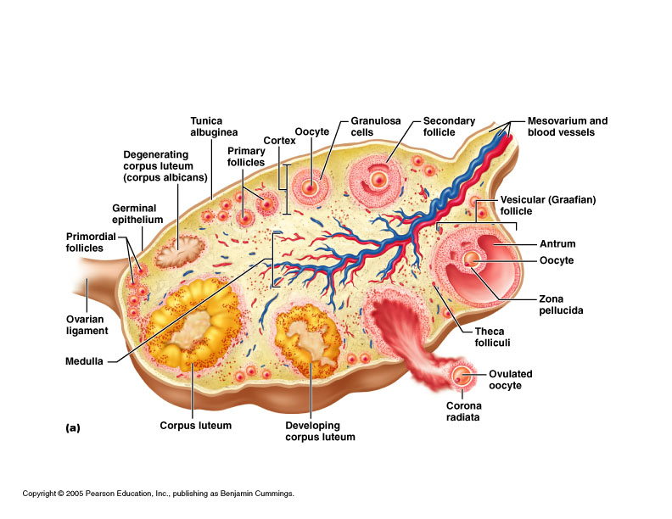
Structure of ovary

Slide 6
Oogenesis
Is the process by which a diploid somatic cell, an oogonium in the fetal ovary becomes a haploid ovum in the adult after fertilization. Takes place inside ovarian follicles in ovaries a part of ovarian cycle.
Stages :
-Oogonia: in the fetal ovary divide mitotic ally to form diploid primary oocyte at are located in primordial follicles.
-Primary oocyte: immediately begin the first meiotic division, which arrests a prophase. Primordial follicles present from birth until puberty, resulting in ovulation.
-Secondary oocyte: is formed during the hours preceding ovulation in each ovarian cycle. that is ovulated, begins meiosis II but arrest in metaphase.

Slide 7
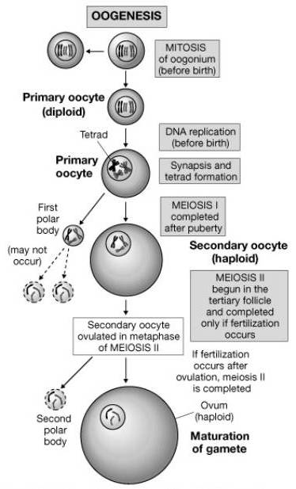
-An ovum: the mature haploid germ cell is formed only if fertilization occurs.

